Slide 1

Tower of Madness
Presenter: Janna Lomiba
Karl alvarado
Samuel cano gallo
Sen Bellotiny Donissaint
Trevor obodoechina

Slide 2

Agenda
Introduction
PLOT, characters, ETC…
task distribution
IMPLEMENTATION
challenges faced

Slide 3

Introduction to Tower of Madness
In this project we were asked to….

Slide 4
Introduction to Tower of Madness
Reasons for the chosen game: ……….
Goal of the game: …………..
Type of game: ……….
General gameplay: …………

Slide 5
Characters, Plot, & Settings
Gustavo the Bounded
Tower of Madness
A Faded World
Gustavo vs the Tower of Madness
The Corrupted Souls

Slide 6
Task Description
Janna:
Karl:
Samuel:
Sen:
Trevor:

Slide 7

Implementation
Level Design
HUB, Sounds, Scripts, etc.…
Player & AI Actions

Slide 8
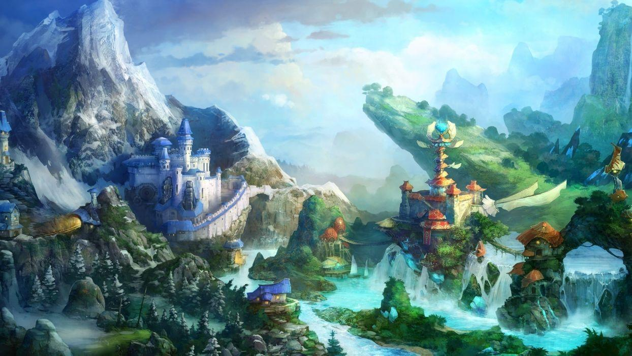
Level Design General Description

Slide 9
Level Design

Slide 10
Level Design (cont.)

Slide 11
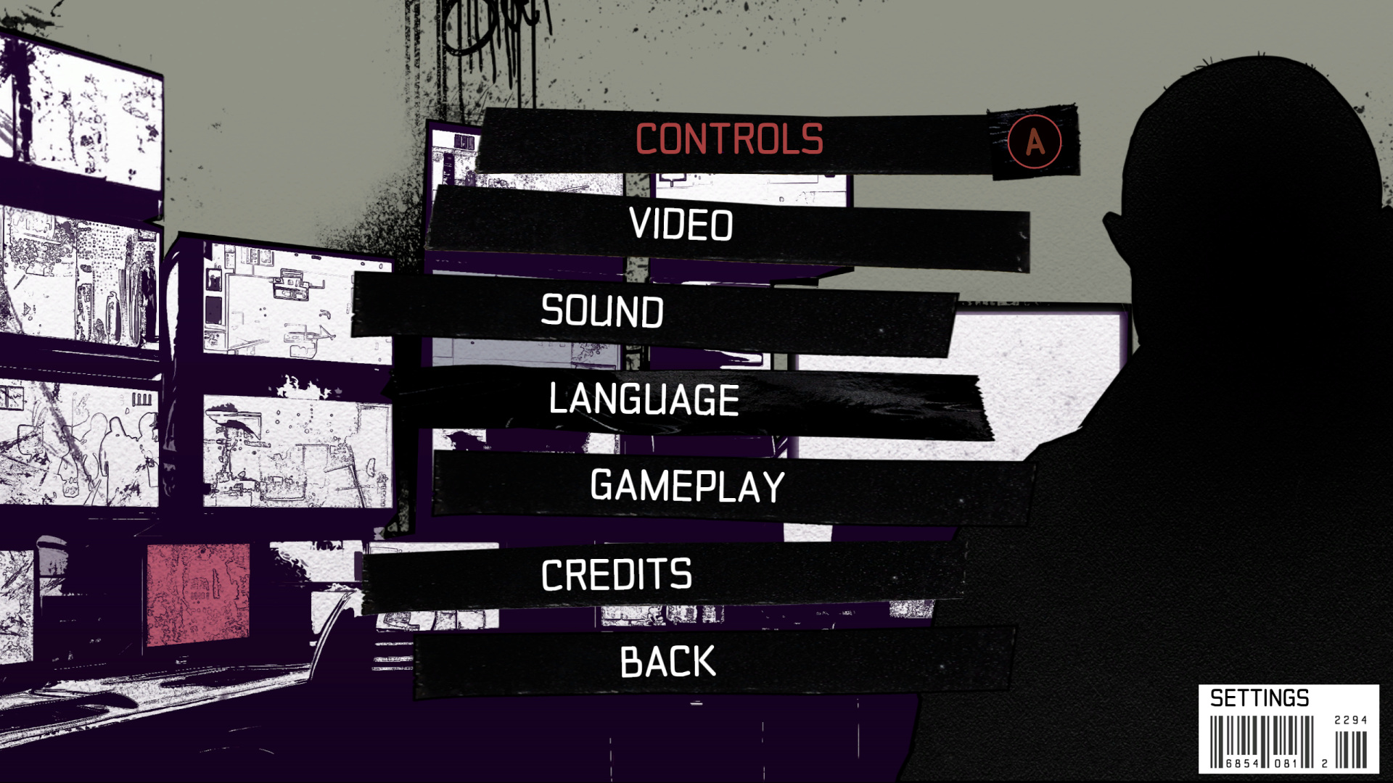
HUB, Sound, Scripts, etc. General Description

Slide 12
HUB

Slide 13
Sounds

Slide 14
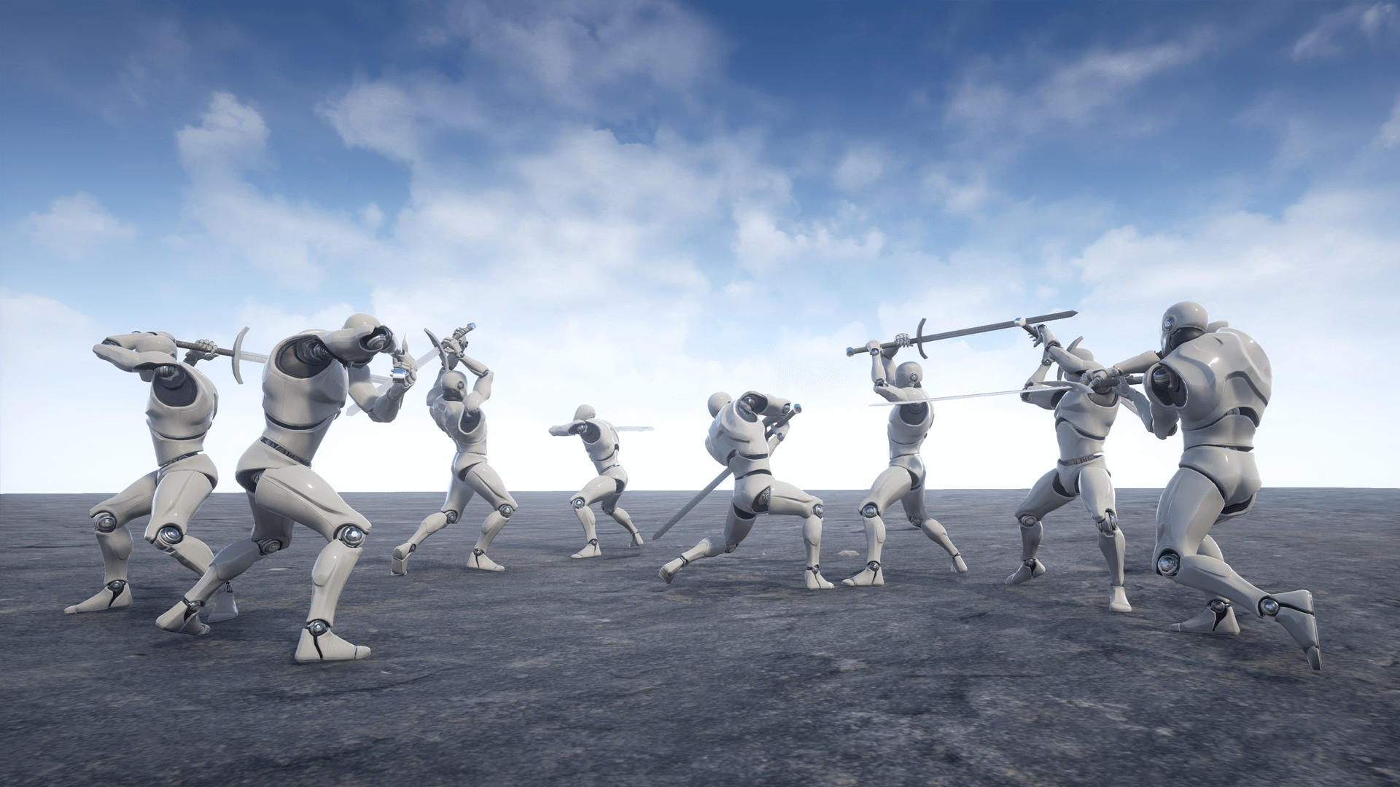
Player & AI Movement General Description

Slide 15
Player Movement

Slide 16
AI Movement
Programmed using….

Slide 17

Challenges Faced

Slide 18
Challenges

Slide 19

THANK YOU FOR LISTENING!!

